Slide 1
Computer Systems:
A Programmer’s Perspective
程序设计与计算机系统
Lecture 6
Memory Hierarchy
November 26, 2020
Wu junmin (jmwu@ustc.edu.cn)

Slide 2
Today
Storage technologies and trends
Locality of reference
Caching in the memory hierarchy

Slide 3
Random-Access Memory (RAM)
Key features
  RAM is traditionally packaged as a chip.
  Basic storage unit is normally a cell (one bit per cell).
  Multiple RAM chips form a memory.
Static RAM (SRAM)
  Each cell stores a bit with a four or six-transistor circuit.
  Retains value indefinitely, as long as it is kept powered.
  Relatively insensitive to electrical noise (EMI), radiation, etc.
  Faster and more expensive than DRAM.
Dynamic RAM (DRAM)
  Each cell stores bit with a capacitor. One transistor is used for access
  Value must be refreshed every 10-100 ms.
  More sensitive to disturbances (EMI, radiation,…) than SRAM.
  Slower and cheaper than SRAM.

Slide 4
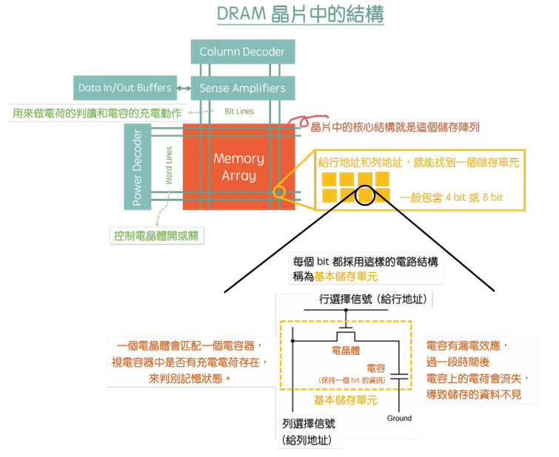
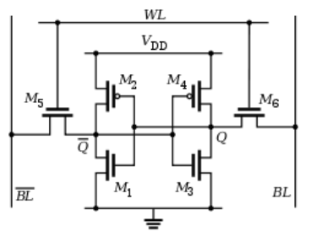
SRAM vs DRAM Summary
Trans. Access Needs Needs
per bit time refresh? EDC? Cost Applications
SRAM 4 or 6 1X No Maybe 100x Cache memories
DRAM 1 10X Yes Yes 1X Main memories,
frame buffers

Slide 5
Conventional DRAM Organization
d x w DRAM:
  dw total bits organized as d supercells of size w bits
16 x 8 DRAM chip
cols
Memory
controller
0
1
2
3
2 bits
/
0
addr
1
rows
2
supercell
(2,1)
(to/from CPU)
3
8 bits
/
data
Internal row buffer
Notes:
2015年12月,三星电子近日宣布，将在全球首家推出128GB DRAM内存。该产品采用3D立体硅穿孔封装技术，容量和速度提升2倍，能耗减少50%。已经正式进入量产。
据悉，在这个小小的内存芯片中，三星内置了 144 个芯片，形成了 36×4GB DRAM 封装，每个封装中有 4×8Gb 芯片，而且该内存芯片采用了三星最先进的 20毫微米工艺制造。

Slide 6
Reading DRAM Supercell (2,1)
Step 1(a): Row access strobe (RAS) selects row 2.
Step 1(b): Row 2 copied from DRAM array to row buffer.
16 x 8 DRAM chip
Cols
Memory
controller
RAS = 2
0
1
2
3
2
/
0
addr
1
Rows
2
8
/
3
data
Internal row buffer

Slide 7
Reading DRAM Supercell (2,1)
Step 2(a): Column access strobe (CAS) selects column 1.
Step 2(b): Supercell (2,1) copied from buffer to data lines, and eventually back to the CPU.
16 x 8 DRAM chip
Cols
Memory
controller
CAS = 1
0
1
2
3
2
/
0
addr
To CPU
1
Rows
2
supercell
(2,1)
3
8
/
data
supercell
(2,1)
Internal row buffer

Slide 8
Memory Modules
addr (row = i, col = j)
: supercell (i,j)
DRAM 0
64 MB
memory module
consisting of
eight 8Mx8 DRAMs
DRAM 7
bits
56-63
bits
48-55
bits
40-47
bits
32-39
bits
24-31
bits
16-23
bits
8-15
bits
0-7
63
63
56
56
55
55
48
48
47
47
40
40
39
39
32
32
31
31
24
24
23
23
16
16
15
15
8
8
7
7
0
0
Memory
controller
64-bit doubleword at main memory address A
64-bit doubleword

Slide 9
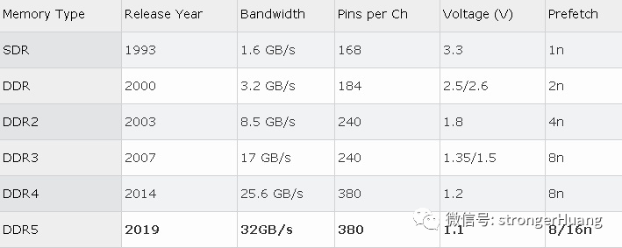
Enhanced DRAMs
Basic DRAM cell has not changed since its invention in 1966.
  Commercialized by Intel in 1970.
DRAM cores with better interface logic and faster I/O :
  Synchronous DRAM (SDRAM)
    Uses a conventional clock signal instead of asynchronous control
    Allows reuse of the row addresses (e.g., RAS, CAS, CAS, CAS)
  Double data-rate synchronous DRAM (DDR SDRAM)
    Double edge clocking sends two bits per cycle per pin
    Different types distinguished by size of small prefetch buffer:
      DDR (2 bits), DDR2 (4 bits), DDR4 (8 bits),DDR5(8/16bits)
    Standard for most server and desktop systems
    Intel Core i7 supports only DDR3 SDRAM

Slide 10
Nonvolatile Memories
DRAM and SRAM are volatile memories
  Lose information if powered off.
Nonvolatile memories retain value even if powered off
  Read-only memory (ROM): programmed during production
  Programmable ROM (PROM): can be programmed once
  Eraseable PROM (EPROM): can be bulk erased (UV, X-Ray)
  Electrically eraseable PROM (EEPROM): electronic erase capability
  Flash memory: EEPROMs with partial (sector) erase capability
    Wears out after about 100,000 erasings.
Uses for Nonvolatile Memories
  Firmware programs stored in a ROM (BIOS, controllers for disks, network cards, graphics accelerators, security subsystems,…)
  Solid state disks (replace rotating disks in thumb drives, smart phones, mp3 players, tablets, laptops,…)
  Disk caches

Slide 11
Traditional Bus Structure Connecting CPU and Memory
A bus is a collection of parallel wires that carry address, data, and control signals.
Buses are typically shared by multiple devices.
CPU chip
Register file
ALU
System bus
Memory bus
Main
memory
Bus interface
I/O
bridge

Slide 12
Memory Read Transaction (1)
CPU places address A on the memory bus.
Register file
Load operation: movl A, %eax
ALU
%eax
Main memory
I/O bridge
A
0
Bus interface
x
A

Slide 13
Memory Read Transaction (2)
Main memory reads A from the memory bus, retrieves word x, and places it on the bus.
Register file
Load operation: movl A, %eax
ALU
%eax
Main memory
I/O bridge
x
0
Bus interface
x
A

Slide 14
Memory Read Transaction (3)
CPU read word x from the bus and copies it into register %eax.
Register file
Load operation: movl A, %eax
ALU
%eax
x
Main memory
I/O bridge
0
Bus interface
x
A

Slide 15
Memory Write Transaction (1)
CPU places address A on bus. Main memory reads it and waits for the corresponding data word to arrive.
Register file
Store operation: movl %eax, A
ALU
%eax
y
Main memory
I/O bridge
0
A
Bus interface
A

Slide 16
Memory Write Transaction (2)
CPU places data word y on the bus.
Register file
Store operation: movl %eax, A
ALU
%eax
y
Main memory
I/O bridge
y
0
Bus interface
A

Slide 17
Memory Write Transaction (3)
Main memory reads data word y from the bus and stores it at address A.
register file
Store operation: movl %eax, A
ALU
%eax
y
main memory
I/O bridge
0
bus interface
y
A

Slide 18
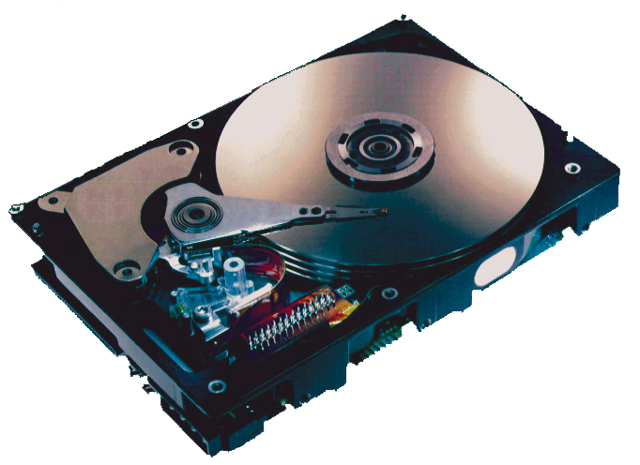
What’s Inside A Disk Drive?
Spindle
Arm
Platters
Actuator
Electronics
(including a
processor
and memory!)
SCSI
connector
Image courtesy of Seagate Technology

Slide 19
Disk Geometry
Disks consist of platters, each with two surfaces.
Each surface consists of concentric rings called tracks.
Each track consists of sectors separated by gaps.
Tracks
Surface
Track k
Gaps
Spindle
Sectors

Slide 20
Disk Geometry (Multiple-Platter View)
Aligned tracks form a cylinder.
Cylinder k
Surface 0
Platter 0
Surface 1
Surface 2
Platter 1
Surface 3
Surface 4
Platter 2
Surface 5
Spindle

Slide 21
Disk Capacity
Capacity: maximum number of bits that can be stored.
  Vendors express capacity in units of gigabytes (GB), where
  1 GB = 10⁹ Bytes (Lawsuit pending! Claims deceptive advertising).
Capacity is determined by these technology factors:
  Recording density (bits/in): number of bits that can be squeezed into a 1 inch segment of a track.
  Track density (tracks/in): number of tracks that can be squeezed into a 1 inch radial segment.
  Areal density (bits/in2): product of recording and track density.
Modern disks partition tracks into disjoint subsets called recording zones
  Each track in a zone has the same number of sectors, determined by the circumference of innermost track.
  Each zone has a different number of sectors/track

Slide 22
Computing Disk Capacity
Capacity = (# bytes/sector) x (avg. # sectors/track) x
(# tracks/surface) x (# surfaces/platter) x
(# platters/disk)
Example:
  512 bytes/sector
  300 sectors/track (on average)
  20,000 tracks/surface
  2 surfaces/platter
  5 platters/disk
Capacity = 512 x 300 x 20000 x 2 x 5
= 30,720,000,000
= 30.72 GB

Slide 23
Disk Operation (Single-Platter View)
The disk surface
spins at a fixed
rotational rate
The read/write head
is attached to the end
of the arm and flies over
the disk surface on
a thin cushion of air.
spindle
spindle
spindle
spindle
spindle
By moving radially, the arm can position the read/write head over any track.

Slide 24
Disk Operation (Multi-Platter View)
Read/write heads
move in unison
from cylinder to cylinder
Arm
Spindle

Slide 25
Disk Structure - top view of single platter
Surface organized into tracks
Tracks divided into sectors
Notes:
Goal:
Show the inefficeincy of current disk requests.
Conveyed Ideas:
Rotational latency is wasted time that can be used to service tasks
Background Information:
None.
Slide Background:
None.
Kill text and arrows

Slide 26
Disk Access
Head in position above a track
Notes:
Goal:
Show the inefficeincy of current disk requests.
Conveyed Ideas:
Rotational latency is wasted time that can be used to service tasks
Background Information:
None.
Slide Background:
None.
Kill text and arrows

Slide 27
Disk Access
Rotation is counter-clockwise
Notes:
Goal:
Show the inefficeincy of current disk requests.
Conveyed Ideas:
Rotational latency is wasted time that can be used to service tasks
Background Information:
None.
Slide Background:
None.
Kill text and arrows

Slide 28
Disk Access – Read
About to read blue sector
Notes:
Goal:
Show the inefficeincy of current disk requests.
Conveyed Ideas:
Rotational latency is wasted time that can be used to service tasks
Background Information:
None.
Slide Background:
None.
Kill text and arrows

Slide 29
Disk Access – Read
After BLUE read
After reading blue sector
Notes:
Goal:
Show the inefficeincy of current disk requests.
Conveyed Ideas:
Rotational latency is wasted time that can be used to service tasks
Background Information:
None.
Slide Background:
None.
Kill text and arrows

Slide 30
Disk Access – Read
After BLUE read
Red request scheduled next
Notes:
Goal:
Show the inefficeincy of current disk requests.
Conveyed Ideas:
Rotational latency is wasted time that can be used to service tasks
Background Information:
None.
Slide Background:
None.
Kill text and arrows

Slide 31
Disk Access – Seek
After BLUE read
Seek for RED
Seek to red’s track
Notes:
Goal:
Show the inefficeincy of current disk requests.
Conveyed Ideas:
Rotational latency is wasted time that can be used to service tasks
Background Information:
None.
Slide Background:
None.
Kill text and arrows

Slide 32
Disk Access – Rotational Latency
After BLUE read
Seek for RED
Rotational latency
Wait for red sector to rotate around
Notes:
Goal:
Show the inefficeincy of current disk requests.
Conveyed Ideas:
Rotational latency is wasted time that can be used to service tasks
Background Information:
None.
Slide Background:
None.
Kill text and arrows

Slide 33
Disk Access – Read
After BLUE read
Seek for RED
Rotational latency
After RED read
Complete read of red
Notes:
Goal:
Show the inefficeincy of current disk requests.
Conveyed Ideas:
Rotational latency is wasted time that can be used to service tasks
Background Information:
None.
Slide Background:
None.
Kill text and arrows

Slide 34
Disk Access – Service Time Components
After BLUE read
Seek for RED
Rotational latency
After RED read
Data transfer
Seek
Rotational
latency
Data transfer
Notes:
Goal:
Show the inefficeincy of current disk requests.
Conveyed Ideas:
Rotational latency is wasted time that can be used to service tasks
Background Information:
None.
Slide Background:
None.
Kill text and arrows

Slide 35
Disk Access Time
Average time to access some target sector approximated by :
  Taccess = Tavg seek + Tavg rotation + Tavg transfer
Seek time (Tavg seek)
  Time to position heads over cylinder containing target sector.
  Typical Tavg seek is 3—9 ms
Rotational latency (Tavg rotation)
  Time waiting for first bit of target sector to pass under r/w head.
  Tavg rotation = 1/2 x 1/RPMs x 60 sec/1 min
  Typical Tavg rotation = 7200 RPMs
Transfer time (Tavg transfer)
  Time to read the bits in the target sector.
  Tavg transfer = 1/RPM x 1/(avg # sectors/track) x 60 secs/1 min.

Slide 36
Disk Access Time Example
Given:
  Rotational rate = 7,200 RPM
  Average seek time = 9 ms.
  Avg # sectors/track = 400.
Derived:
  Tavg rotation = 1/2 x (60 secs/7200 RPM) x 1000 ms/sec = 4 ms.
  Tavg transfer = 60/7200 RPM x 1/400 secs/track x 1000 ms/sec = 0.02 ms
  Taccess = 9 ms + 4 ms + 0.02 ms
Important points:
  Access time dominated by seek time and rotational latency.
  First bit in a sector is the most expensive, the rest are free.
  SRAM access time is about 4 ns/doubleword, DRAM about 60 ns
    Disk is about 40,000 times slower than SRAM,
    2,500 times slower then DRAM.

Slide 37
Logical Disk Blocks
Modern disks present a simpler abstract view of the complex sector geometry:
  The set of available sectors is modeled as a sequence of b-sized logical blocks (0, 1, 2, ...)
Mapping between logical blocks and actual (physical) sectors
  Maintained by hardware/firmware device called disk controller.
  Converts requests for logical blocks into (surface,track,sector) triples.
Allows controller to set aside spare cylinders for each zone.
  Accounts for the difference in “formatted capacity” and “maximum capacity”.

Slide 38
I/O Bus
CPU chip
Register file
ALU
System bus
Memory bus
Main
memory
Bus interface
I/O
bridge
I/O bus
Expansion slots for
other devices such
as network adapters.
USB
controller
Graphics
adapter
Disk
controller
Mouse
Keyboard
Monitor
Disk

Slide 39
Reading a Disk Sector (1)
CPU chip
CPU initiates a disk read by writing a command, logical block number, and destination memory address to a port (address) associated with disk controller.
Register file
ALU
Main
memory
Bus interface
I/O bus
USB
controller
Graphics
adapter
Disk
controller
mouse
keyboard
Monitor
Disk

Slide 40
Reading a Disk Sector (2)
CPU chip
Disk controller reads the sector and performs a direct memory access (DMA) transfer into main memory.
Register file
ALU
Main
memory
Bus interface
I/O bus
USB
controller
Graphics
adapter
Disk
controller
Mouse
Keyboard
Monitor
Disk

Slide 41
Reading a Disk Sector (3)
CPU chip
When the DMA transfer completes, the disk controller notifies the CPU with an interrupt (i.e., asserts a special “interrupt” pin on the CPU)
Register file
ALU
Main
memory
Bus interface
I/O bus
USB
controller
Graphics
adapter
Disk
controller
Mouse
Keyboard
Monitor
Disk

Slide 42
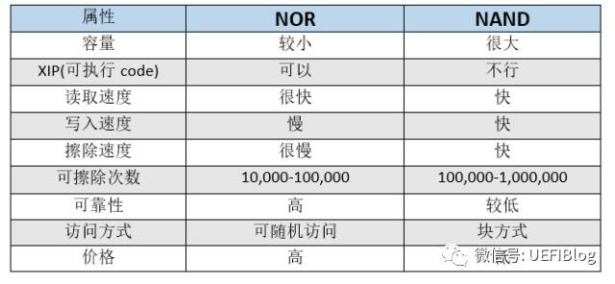
Solid State Disks (SSDs)
I/O bus
Requests to read and
write logical disk blocks
Solid State Disk (SSD)
Flash
translation layer
Flash memory
Block 0
Block B-1
…
…
…
Page 0
Page 1
Page P-1
Page 0
Page 1
Page P-1
Pages: 512KB to 4KB, Blocks: 32 to 128 pages
Data read/written in units of pages.
Page can be written only after its block has been erased
A block wears out after 100,000 repeated writes.
Notes:
发明人 富士雄 ，东芝公司
NOR Flash ：可执行特性，主要用在BIOS，市场较小
NAND Flash：

Slide 43
SSD Performance Characteristics
Sequential read tput 250 MB/s Sequential write tput 170 MB/s
Random read tput 140 MB/s Random write tput 14 MB/s
Rand read access 30 us Random write access 300 us
Why are random writes so slow?
  Erasing a block is slow (around 1 ms)
  Write to a page triggers a copy of all useful pages in the block
    Find an unused block (new block) and erase it
    Write the page into the new block
    Copy other pages from old block to the new block

Slide 44
SSD Tradeoffs vs Rotating Disks
Advantages
  No moving parts → faster, less power, more rugged
Disadvantages
  Have the potential to wear out
    Mitigated by “wear leveling logic” in flash translation layer
    E.g. Intel X25 guarantees 1 petabyte (10¹⁵ bytes) of random writes before they wear out
  In 2010, about 100 times more expensive per byte
Applications
  MP3 players, smart phones, laptops
  Beginning to appear in desktops and servers

Slide 45
Storage Trends
SRAM
Metric 1980 1985 1990 1995 2000 2005 2010 2010:1980
$/MB 19,200 2,900 320 256 100 75 60 320
access (ns) 300 150 35 15 3 2 1.5 200
DRAM
Metric 1980 1985 1990 1995 2000 2005 2010 2010:1980
$/MB 8,000 880 100 30 1 0.1 0.06 130,000
access (ns) 375 200 100 70 60 50 40 9
typical size (MB) 0.064 0.256 4 16 64 2,000 8,000 125,000
Disk
Metric 1980 1985 1990 1995 2000 2005 2010 2010:1980
$/MB 500 100 8 0.30 0.01 0.005 0.0003 1,600,000
access (ms) 87 75 28 10 8 4 3 29
typical size (MB) 1 10 160 1,000 20,000 160,000 1,500,000 1,500,000

Slide 46
CPU Clock Rates
Inflection point in computer history
when designers hit the “Power Wall”
1980 1990 1995 2000 2003 2005 2010 2010:1980
CPU 8080 386 Pentium P-III P-4 Core 2 Core i7 ---
Clock
rate (MHz) 1 20 150 600 3300 2000 2500 2500
Cycle
time (ns) 1000 50 6 1.6 0.3 0.50 0.4 2500
Cores 1 1 1 1 1 2 4 4
Effective
cycle 1000 50 6 1.6 0.3 0.25 0.1 10,000
time (ns)

Slide 47
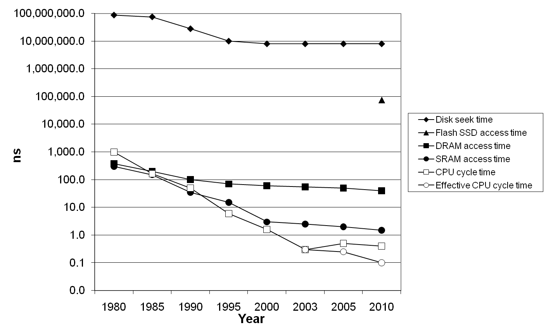
The CPU-Memory Gap
Disk
SSD
DRAM
CPU

Slide 48
Locality to the Rescue!
The key to bridging this CPU-Memory gap is a fundamental property of computer programs known as locality

Slide 49
Today
Storage technologies and trends
Locality of reference
Caching in the memory hierarchy

Slide 50
Locality
Principle of Locality: Programs tend to use data and instructions with addresses near or equal to those they have used recently
Temporal locality:
  Recently referenced items are likely
  to be referenced again in the near future
Spatial locality:
  Items with nearby addresses tend
  to be referenced close together in time

Slide 51
Locality Example
sum = 0;
for (i = 0; i < n; i++)
sum += a[i];
return sum;
Data references
  Reference array elements in succession (stride-1 reference pattern).
  Reference variable sum each iteration.
Instruction references
  Reference instructions in sequence.
  Cycle through loop repeatedly.
Spatial locality
Temporal locality
Spatial locality
Temporal locality

Slide 52
Qualitative Estimates of Locality
Claim: Being able to look at code and get a qualitative sense of its locality is a key skill for a professional programmer.
Question: Does this function have good locality with respect to array a?
int sum_array_rows(int a[M][N])
{
int i, j, sum = 0;
for (i = 0; i < M; i++)
for (j = 0; j < N; j++)
sum += a[i][j];
return sum;
}

Slide 53
Locality Example
Question: Does this function have good locality with respect to array a?
int sum_array_cols(int a[M][N])
{
int i, j, sum = 0;
for (j = 0; j < N; j++)
for (i = 0; i < M; i++)
sum += a[i][j];
return sum;
}

Slide 54
Locality Example
Question: Can you permute the loops so that the function scans the 3-d array a with a stride-1 reference pattern (and thus has good spatial locality)?
int sum_array_3d(int a[M][N][N])
{
int i, j, k, sum = 0;
for (i = 0; i < M; i++)
for (j = 0; j < N; j++)
for (k = 0; k < N; k++)
sum += a[k][i][j];
return sum;
}

Slide 55
Memory Hierarchies
Some fundamental and enduring properties of hardware and software:
  Fast storage technologies cost more per byte, have less capacity, and require more power (heat!).
  The gap between CPU and main memory speed is widening.
  Well-written programs tend to exhibit good locality.
These fundamental properties complement each other beautifully.
They suggest an approach for organizing memory and storage systems known as a memory hierarchy.

Slide 56
Today
Storage technologies and trends
Locality of reference
Caching in the memory hierarchy

Slide 57
An Example Memory Hierarchy
L0:
CPU registers hold words retrieved from L1 cache
Registers
L1:
L1 cache
(SRAM)
Smaller,
faster,
costlier
per byte
L1 cache holds cache lines retrieved from L2 cache
L2:
L2 cache
(SRAM)
L2 cache holds cache lines retrieved from main memory
L3:
Larger,
slower,
cheaper
per byte
Main memory
(DRAM)
Main memory holds disk blocks retrieved from local disks
L4:
Local secondary storage
(local disks)
Local disks hold files retrieved from disks on remote network servers
Remote secondary storage
(tapes, distributed file systems, Web servers)
L5:

Slide 58
Caches
Cache: A smaller, faster storage device that acts as a staging area for a subset of the data in a larger, slower device.
Fundamental idea of a memory hierarchy:
  For each k, the faster, smaller device at level k serves as a cache for the larger, slower device at level k+1.
Why do memory hierarchies work?
  Because of locality, programs tend to access the data at level k more often than they access the data at level k+1.
  Thus, the storage at level k+1 can be slower, and thus larger and cheaper per bit.
Big Idea: The memory hierarchy creates a large pool of storage that costs as much as the cheap storage near the bottom, but that serves data to programs at the rate of the fast storage near the top.

Slide 59
General Cache Concepts
Smaller, faster, more expensive
memory caches a subset of
the blocks
Cache
8
4
9
14
10
3
Data is copied in block-sized transfer units
4
10
Larger, slower, cheaper memory
viewed as partitioned into “blocks”
Memory
0
1
2
3
4
4
5
6
7
8
9
10
10
11
12
13
14
15

Slide 60
General Cache Concepts: Hit
Request: 14
Data in block b is needed
Cache
Block b is in cache:
Hit!
8
9
14
3
14
Memory
0
1
2
3
4
5
6
7
8
9
10
11
12
13
14
15

Slide 61
General Cache Concepts: Miss
Request: 12
Data in block b is needed
Cache
Block b is not in cache:
Miss!
12
8
9
14
3
Block b is fetched from
memory
12
Request: 12
Block b is stored in cache
Placement policy:
determines where b goes
Replacement policy:
determines which block
gets evicted (victim)
Memory
0
1
2
3
4
5
6
7
8
9
10
11
12
12
13
14
15

Slide 62
General Caching Concepts:
Types of Cache Misses
Cold (compulsory) miss
  Cold misses occur because the cache is empty.
Conflict miss
  Most caches limit blocks at level k+1 to a small subset (sometimes a singleton) of the block positions at level k.
    E.g. Block i at level k+1 must be placed in block (i mod 4) at level k.
  Conflict misses occur when the level k cache is large enough, but multiple data objects all map to the same level k block.
    E.g. Referencing blocks 0, 8, 0, 8, 0, 8, ... would miss every time.
Capacity miss
  Occurs when the set of active cache blocks (working set) is larger than the cache.

Slide 63
Examples of Caching in the Hierarchy
Cache Type
What is Cached?
Where is it Cached?
Latency (cycles)
Managed By
Registers
4-8 bytes words
CPU core
0
Compiler
TLB
Address translations
On-Chip TLB
0
Hardware
L1 cache
64-bytes block
On-Chip L1
1
Hardware
L2 cache
64-bytes block
On/Off-Chip L2
10
Hardware
Virtual Memory
4-KB page
Main memory
100
Hardware + OS
Buffer cache
Parts of files
Main memory
100
OS
Disk cache
Disk sectors
Disk controller
100,000
Disk firmware
Network buffer cache
Parts of files
Local disk
10,000,000
AFS/NFS client
Browser cache
Web pages
Local disk
10,000,000
Web browser
Web cache
Web pages
Remote server disks
1,000,000,000
Web proxy server

Slide 64
Summary
The speed gap between CPU, memory and mass storage continues to widen.
Well-written programs exhibit a property called locality.
Memory hierarchies based on caching close the gap by exploiting locality.

